Slide 1
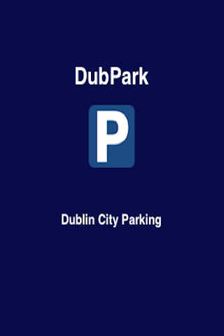

Slide 2
What is DubPark?
DubPark is an app for anyone that needs to park a car in Dublin City centre.
… providing up to the minute information on parking and traffic in the city.

Slide 3
DubPark Features
real-time space availability for 14 carparks
information pages on each of the 14 carparks
shows location of 75 disabled parking spaces
real-time images from 17 city centre traffic cameras
links to resources showing traffic delays
save your favourite carparks & cameras for ease of access

Slide 4
DubPark Features ii
map showing the carparks, disabled spaces, traffic cameras and your current location
directions to each of the carparks, disabled spaces and traffic cameras
option to call carparks directly from the app
general information on parking in Dublin city including parking zones, parking meter tariffs and parking exemptions

Slide 5
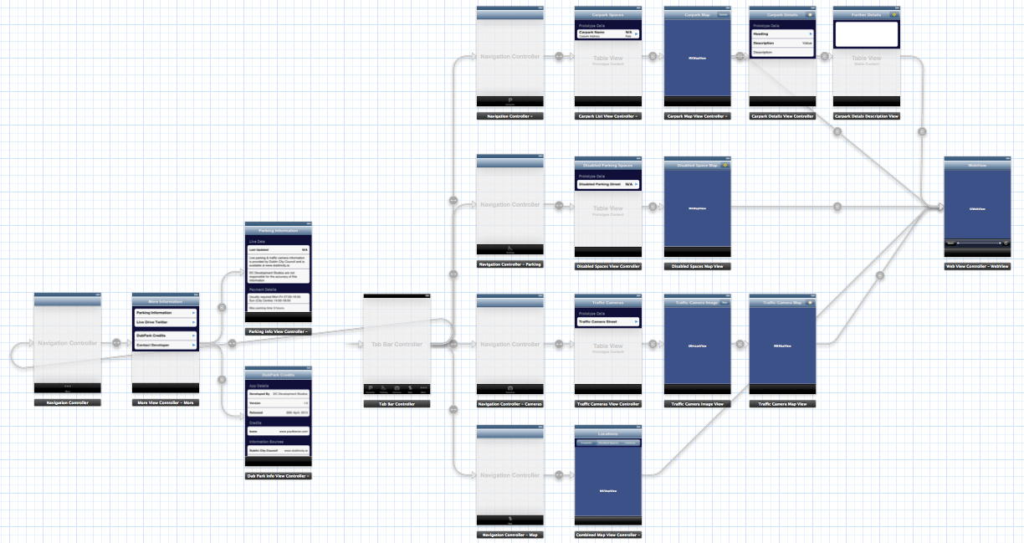
DubPark
View Controllers

Slide 6
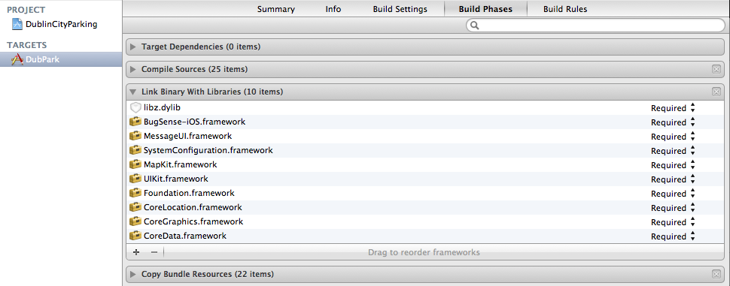
DubPark Frameworks

Slide 7
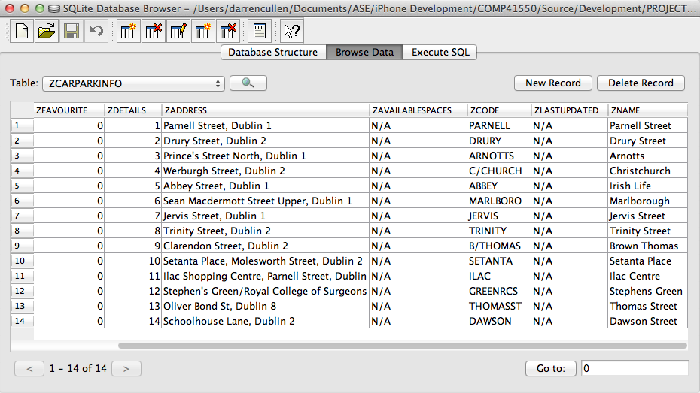
DubPark CoreData
JSON → SQLite

Slide 8
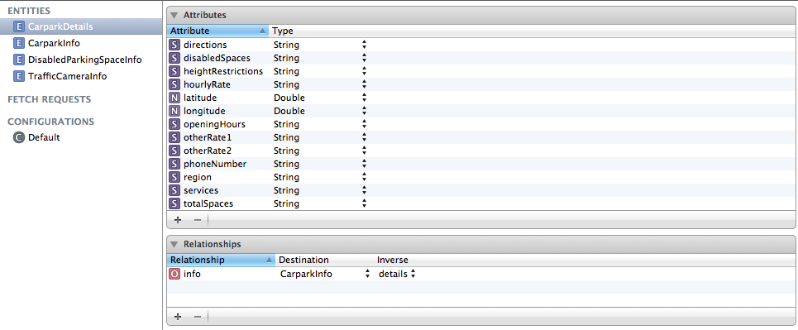
DubPark CoreData ii
JSON → SQLite → Managed Objects

Slide 9
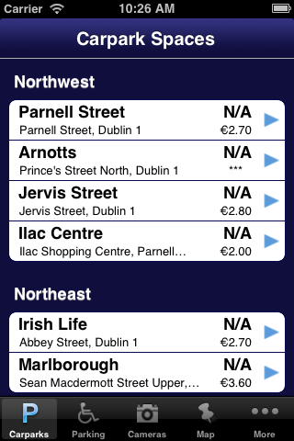

DubPark CoreData iii
→
Parse XML data
from web using
NSOperationQueue
→
JSON → SQLite → Managed Objects → Web XML

Slide 10
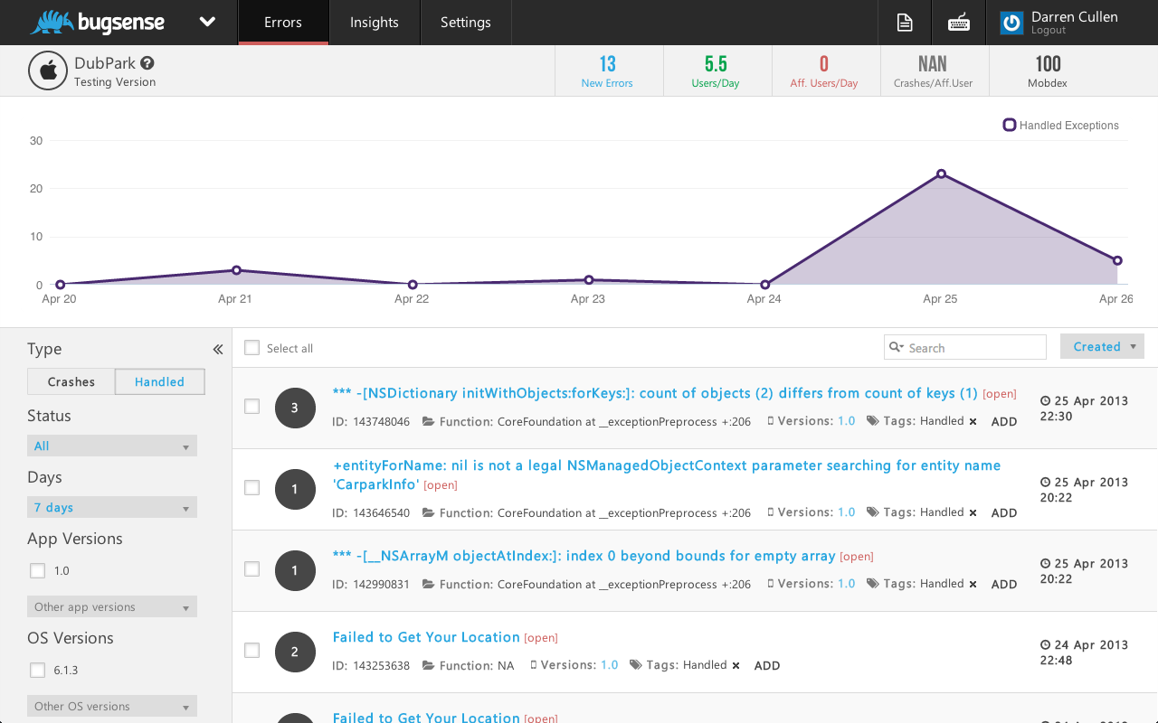
DubPark Error Tracking

Slide 11
Demo ...

